Slide 1
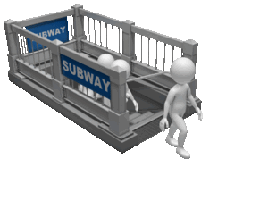
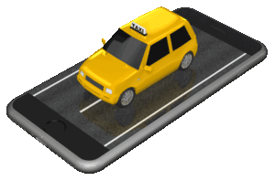

Transportation Solutions for Community Engagement and Employment
David Hoff
Institute for Community Inclusion, UMass Boston
david.hoff@umb.edu – 617-480-9230
www.communityinclusion.org

Slide 2
Handouts
SELN Publication
Getting to Work: Addressing the Transportation Challenge
Transportation Resources – National & Massachusetts
Travel Instruction Resources
Individualized Transportation Plan

Slide 3
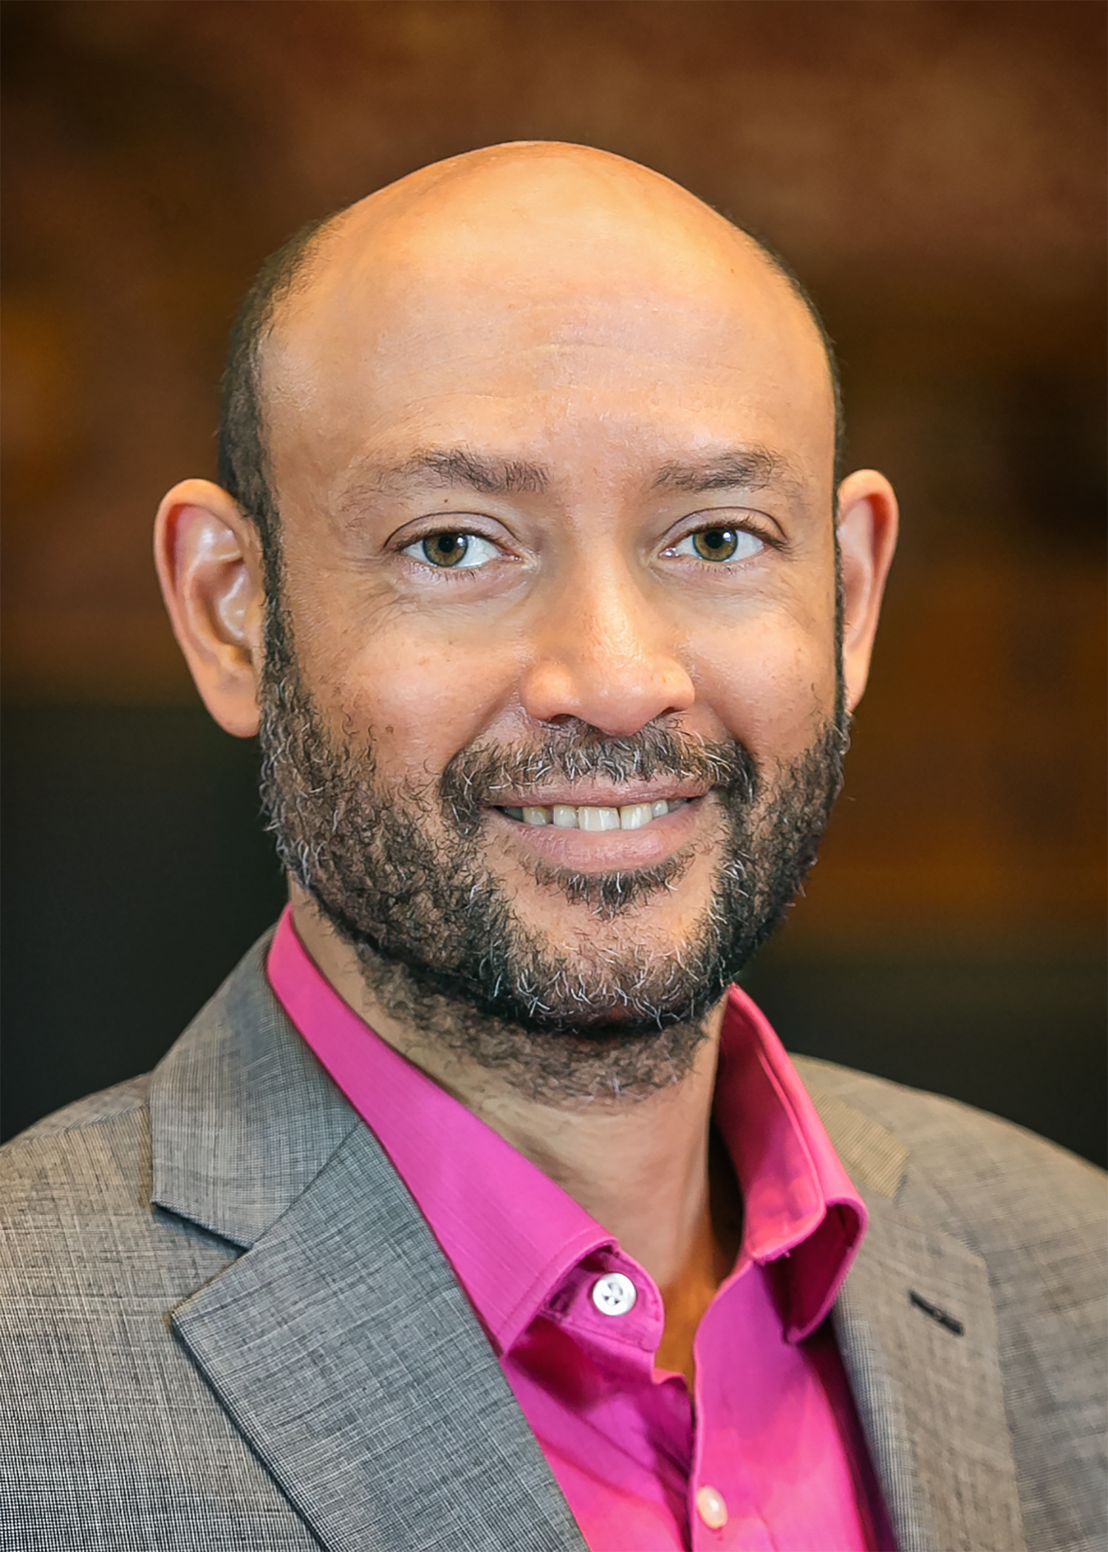
“It’s a form of injustice itself to effectively require car ownership for people to participate fully in our economy and society.”
Quinton Zondervan
Councilor – Cambridge, MA

Slide 4
A Six-Prong Approach
Transportation Solutions
2. Use existing resources differently
1.Change transportation mindset
6. Build transportation competency
3. Build stronger relationships with transportation agencies & experts
4. Build partnerships with others dealing w/transportation issues
5. Advocate!

Slide 5

#1:
Change The Transportation Mindset

Slide 6
Getting beyond a narrow set of options.
“It’s more than just the van.”
Disability Services, Inc

Slide 7
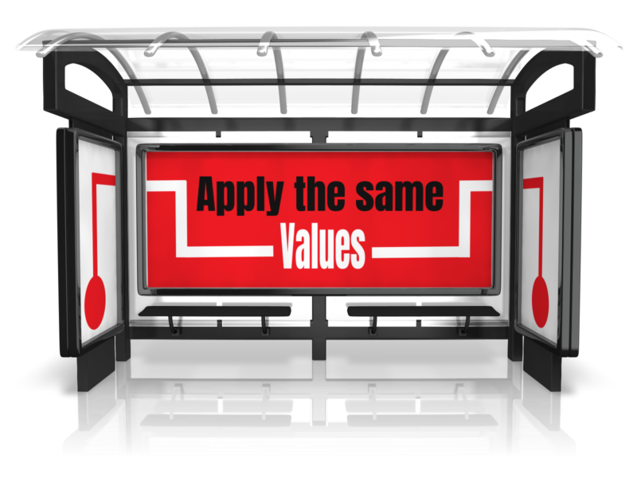
Apply the same values
Integration & Inclusion
Person
Centered
Informed Choice
Nothing about us without us
Self-Determination

Slide 8
I don’t see any transportation possibilities
I DON’T SEE ANY TRANSPORTATION
POSSIBILITIES

Slide 9
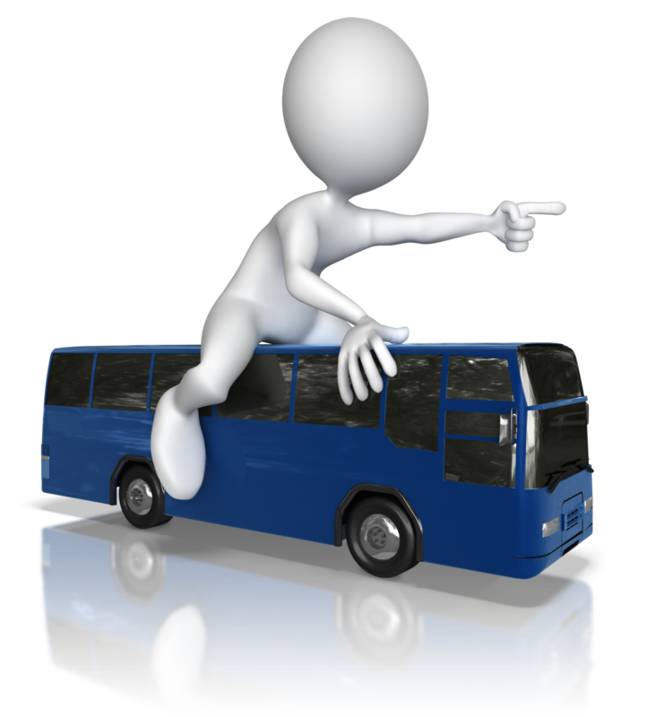
No more passivity by individuals and service providers regarding transportation options

Slide 10
Transportation:
There’s No Magic Solution

Slide 11
Basic Truths About Transportation
Transportation cannot be allowed to be an insurmountable barrier to employment.
When solution does not immediately present itself, don’t say
“There is no transportation”.
While there are no magic answers…there are options – and often lots more than we may realize.

Slide 12

“There are always possibilities.”
Mr. Spock

Slide 13
Transportation
A Self-Determined Approach

Slide 14
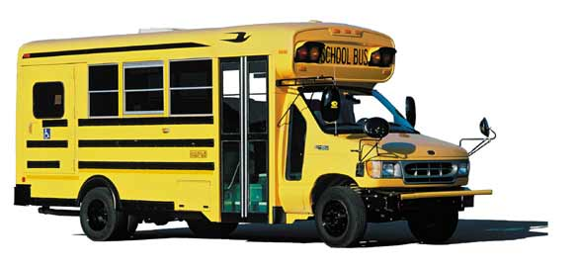
Transportation:
Avoiding Passive Dependence & Acceptance
Starting from an early age if possible, individuals should:
recognize the relationship of transportation to independence, integration, inclusion
have tools to use a range of transportation options
learn to actively self-advocate for and self-manage transportation rather than being a passive recipient

Slide 15
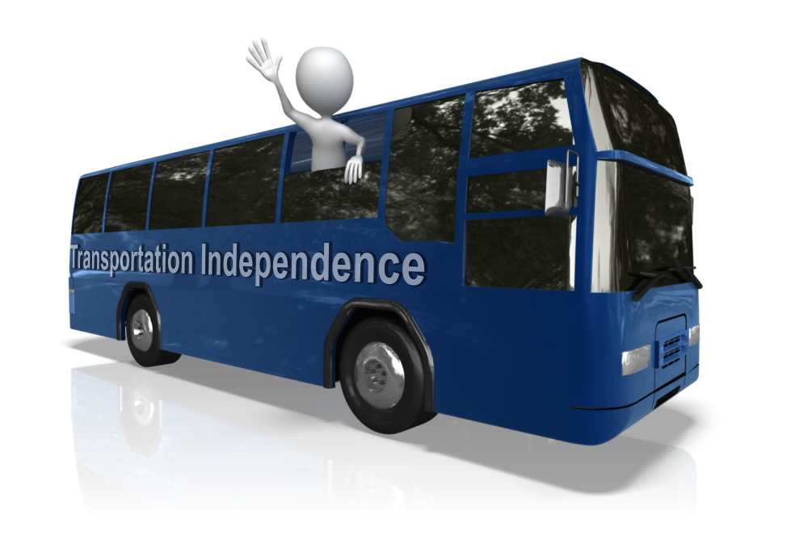
Have Maximum Independence in Transportation as Goal

Slide 16

An Individual Approach to Transportation
Consideration of transportation during early stages of planning, and as part of discovery & job development
Individual determines transportation needs and preferences
Identify and pursue possible options
  Involve anyone and everyone
Determine financial resources to support transportation
Develop an Individual Transportation Plan
Determine transportation support needs
  Travel training, emergency planning, etc.
Implement and modify plan as necessary

Slide 17


A Few Ideas to Get Started
Mass transit
Carpools
Employer resources
Volunteer drivers
Walking & biking
Ride sharing
Paratransit
Taxi/Uber/Lyft, etc.
Social Security Work Incentives
Others

Slide 18



Individuals & Families
Changing expectations and mindset
Emphasizing transportation as key to independence
Travel and safety instruction
Peer-to-peer
One step at a time

Slide 19
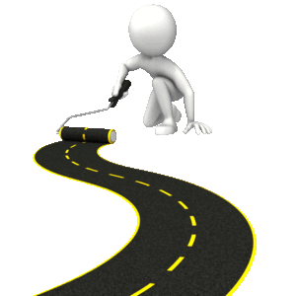
#2:
Use Existing Resources Differently

Slide 20
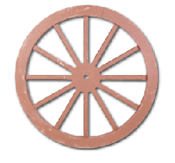
Day Service Transportation
Employment
Transportation

Slide 21
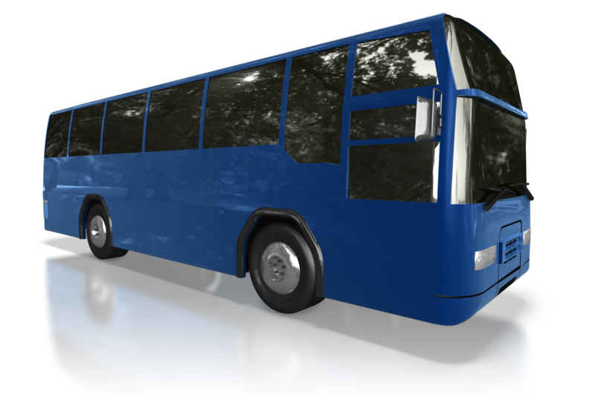

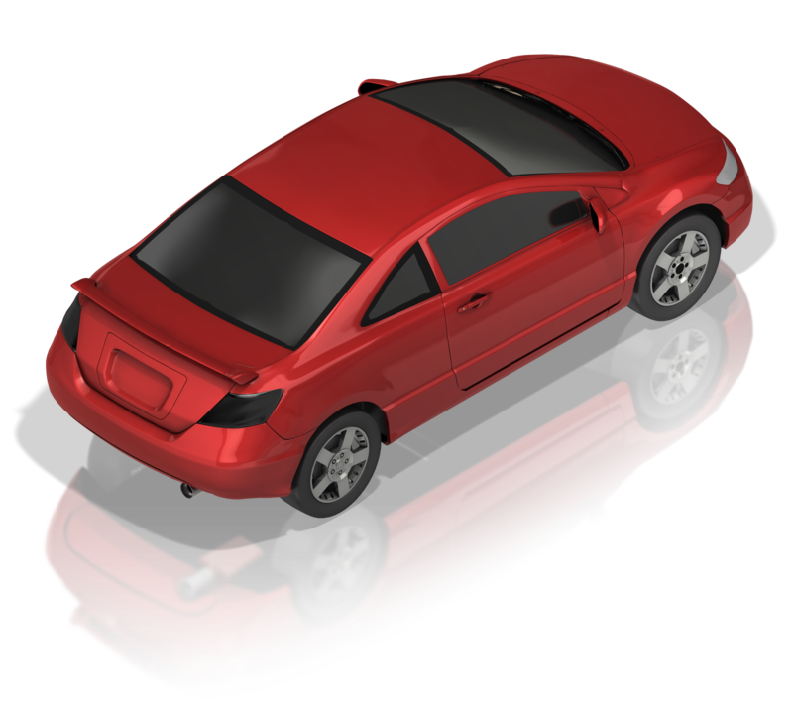
Using Transportation Resources Differently
Provider Resources
System
Resources

Slide 22

#3:
Connect With Transportation Experts

Slide 23
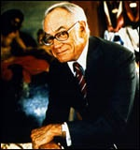
Malcolm Forbes
“It's so much easier to suggest solutions
when you don't know too much about the problem.”

Slide 24


Build Relationships with
Local Transportation Agencies
Build your knowledge of local transportation resources
Create greater awareness by transportation agencies of needs of people with disabilities
Advocate for changes to better meet needs of people with disabilities

Slide 25



Connect with
National Transportation Resources

Slide 26
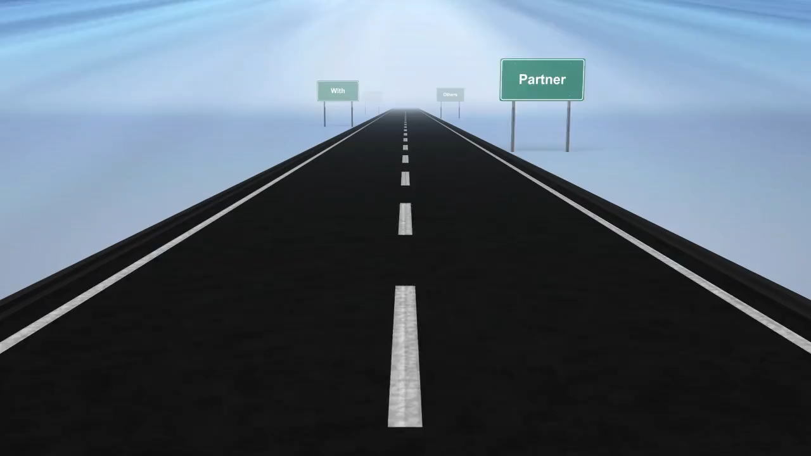
Partner With Others

Slide 27

# 4: Partnering With Others With Transportation Issues
Who:
  Disability providers
  Community organizations
  Elder services
  Faith-based organizations
  Other organizations
What:
  Combine/leverage resources
  Identify additional transportation options
  Partner on funding
  Advocate together for transportation needs

Slide 28
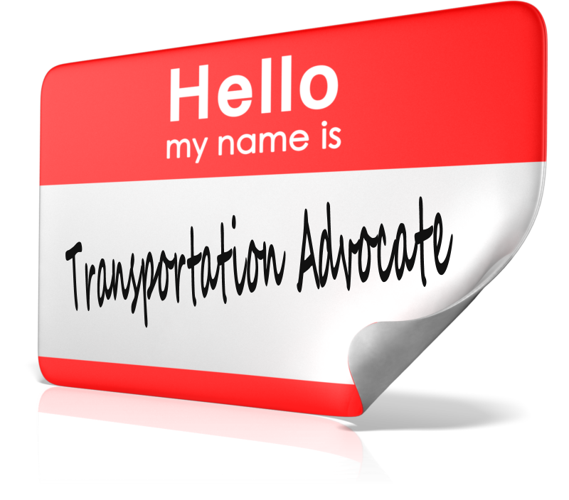
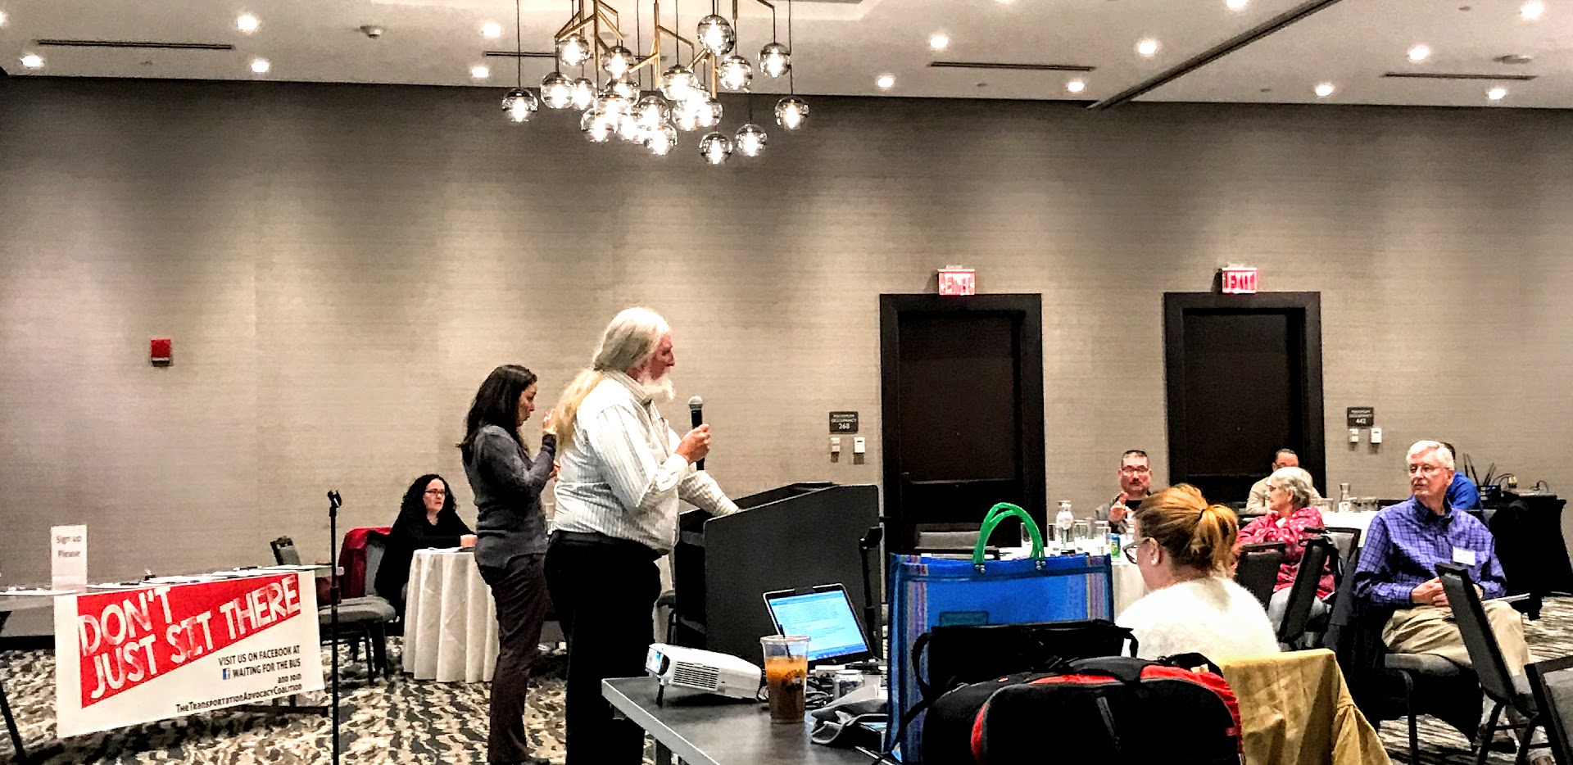
#5: Advocate

Slide 29
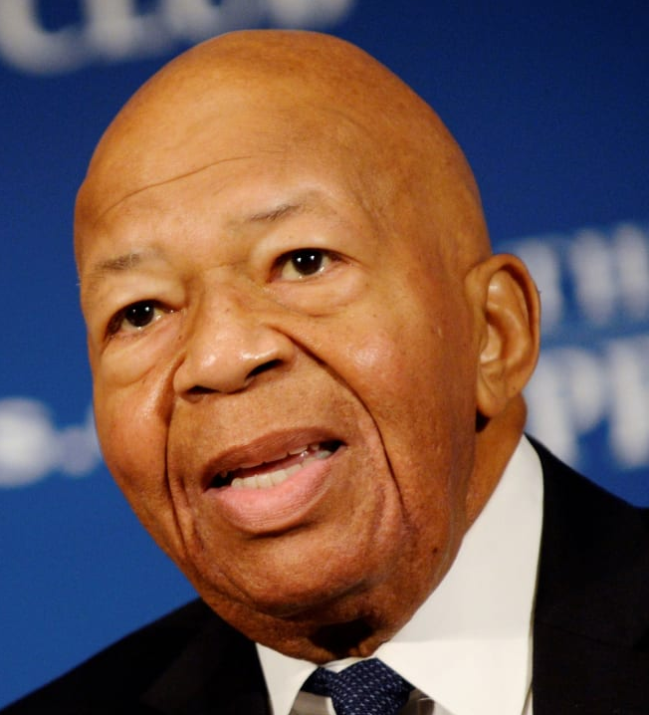
Elijah Cummings
“Our decisions about transportation determine much more than where roads or bridges or tunnels or rail lines will be built.
They determine the connections and barriers that people will encounter in their daily lives - and thus how hard or easy it will be for people to get where they need and want to go."

Slide 30
Advocate!
With who:
Transportation agencies
Planning agencies
County, city, town officials
Political leaders
For what:
More transportation resources
More transportation options
Accessible transportation
More involvement of people with disabilities

Slide 31
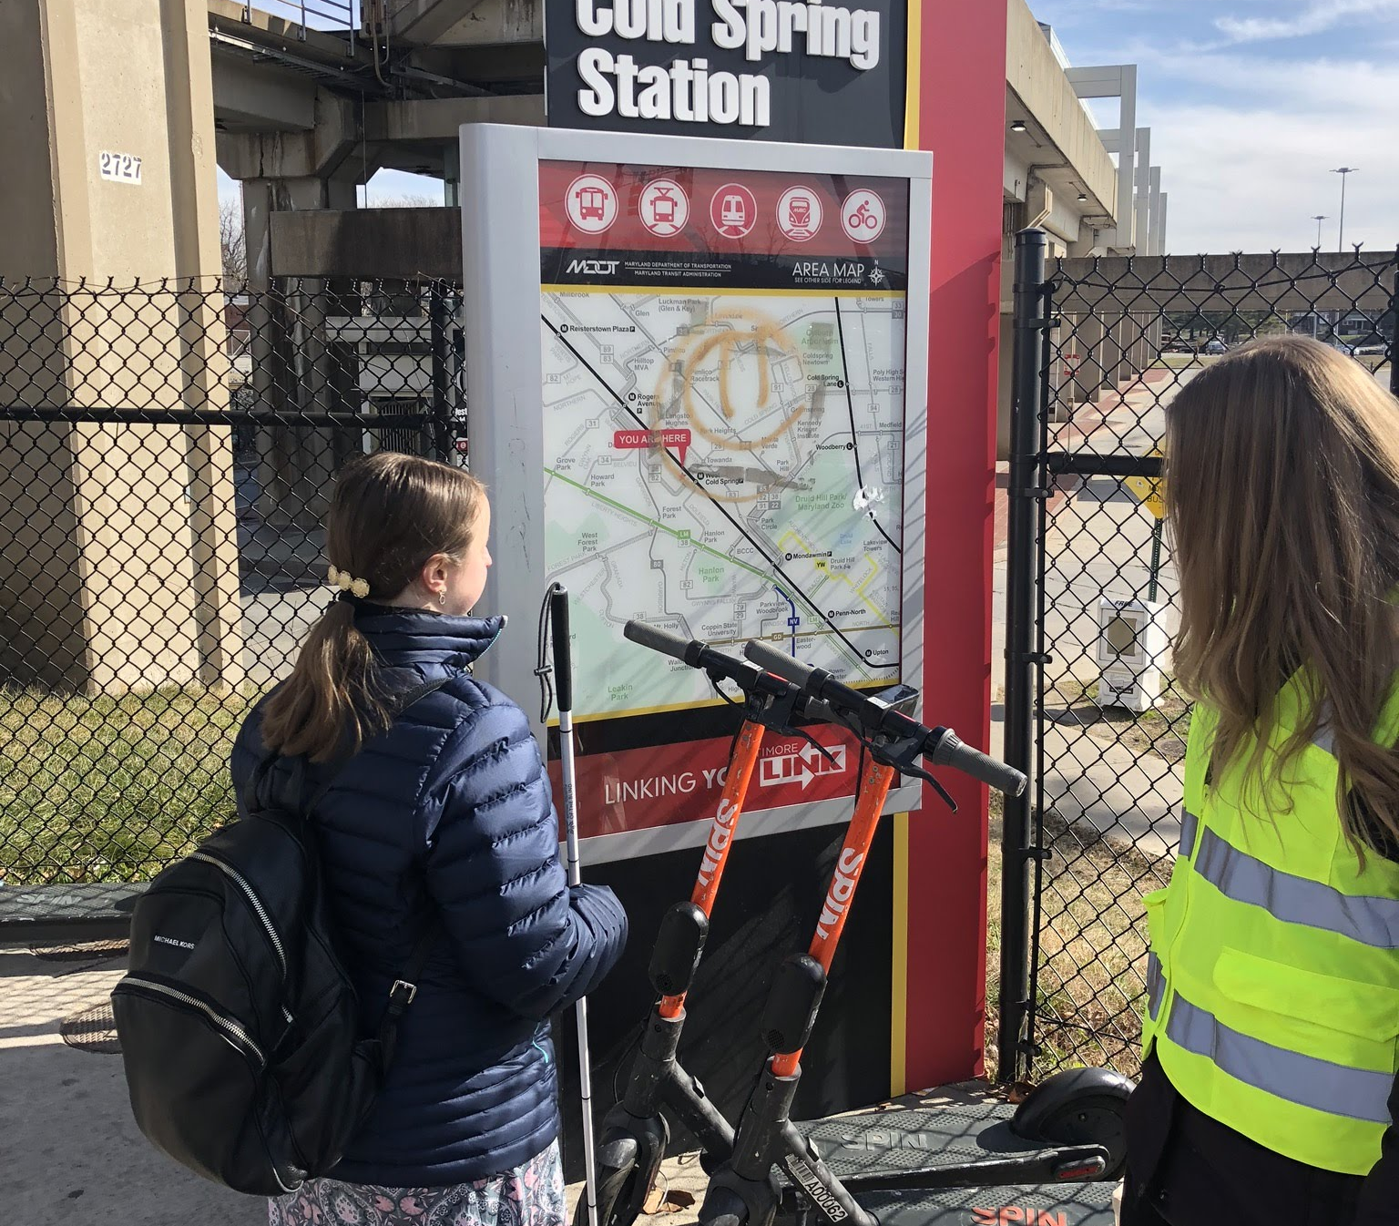
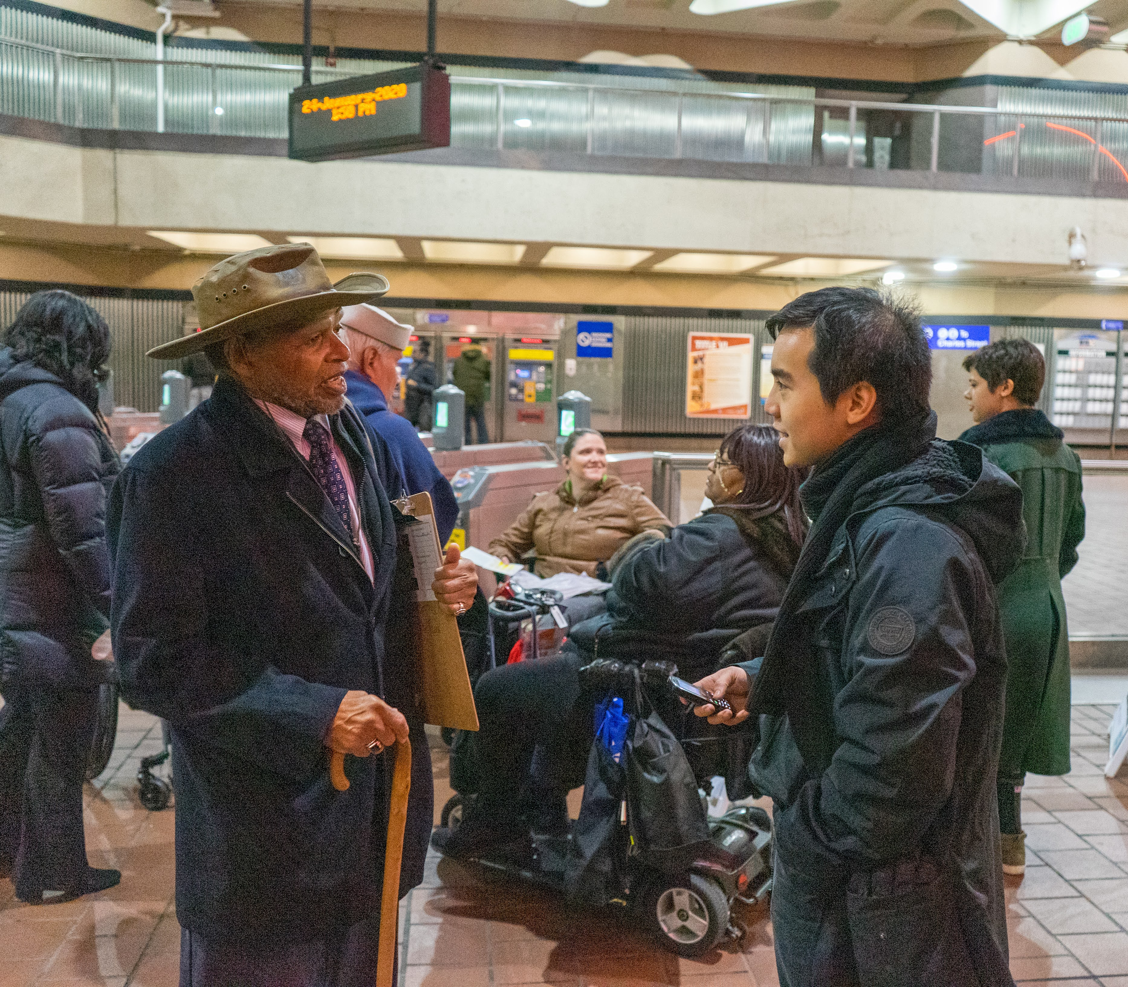
# 6: Build Transportation Competency

Slide 32

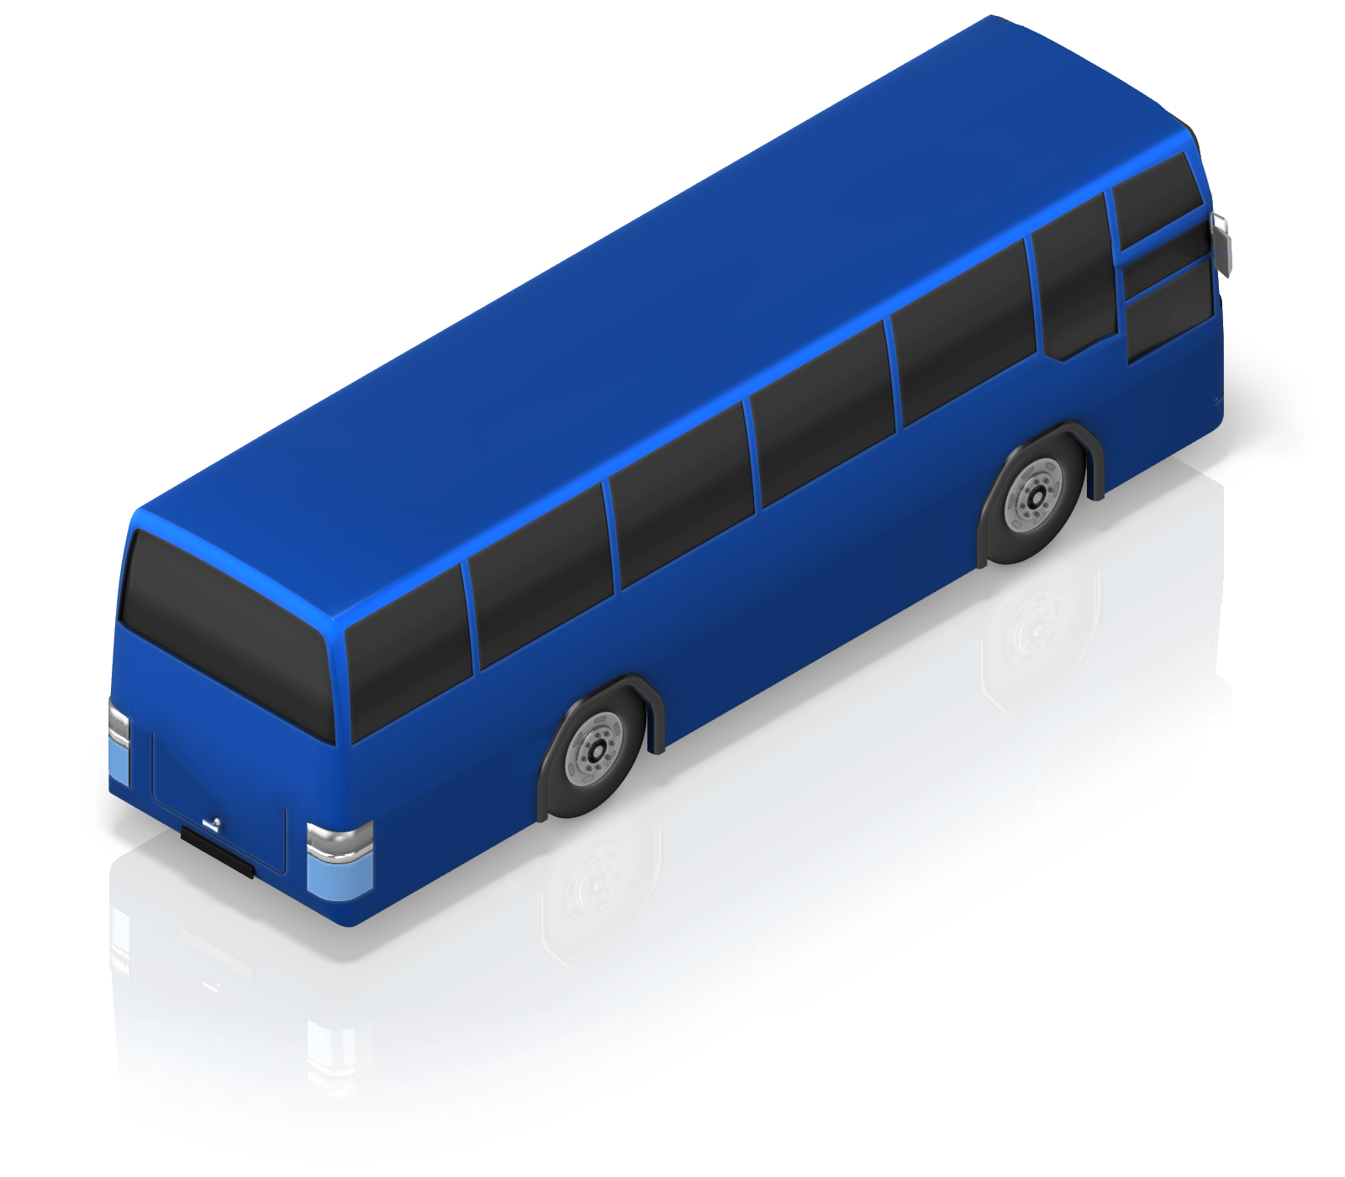
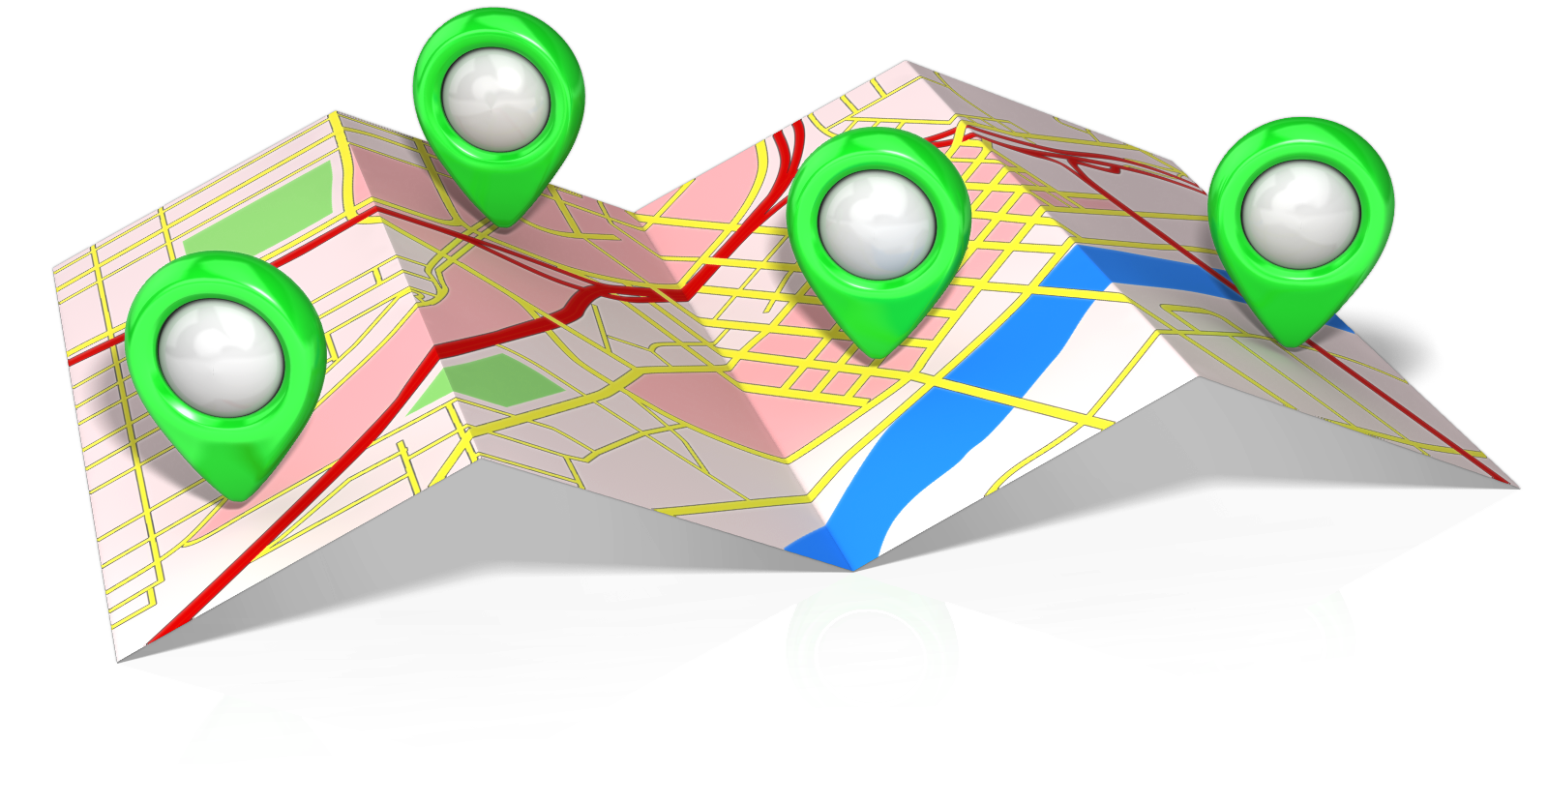
Transportation Competencies
Knowledge of full range of transportation options.
Facilitating individualized, self-determined approach to transportation that maximizes independence and
self-management of transportation.
Use of technology for transportation.
Paying for transportation.
Travel instruction for individuals.
Connections with local transportation officials/providers.
Knowledge and use of local and national resources.
Connections with other organizations experiencing transportation challenges.
Transportation advocacy.

Slide 33


Transportation:
Program Management Issues
Build competency on transportation
Measure how much your program is spending on transportation:
vehicle costs, staff time
  Could these resources be used more effectively and efficiently?
Program goals:
  Minimize reliance by individuals on service provider for transportation
  Minimize environmental impact

Slide 34
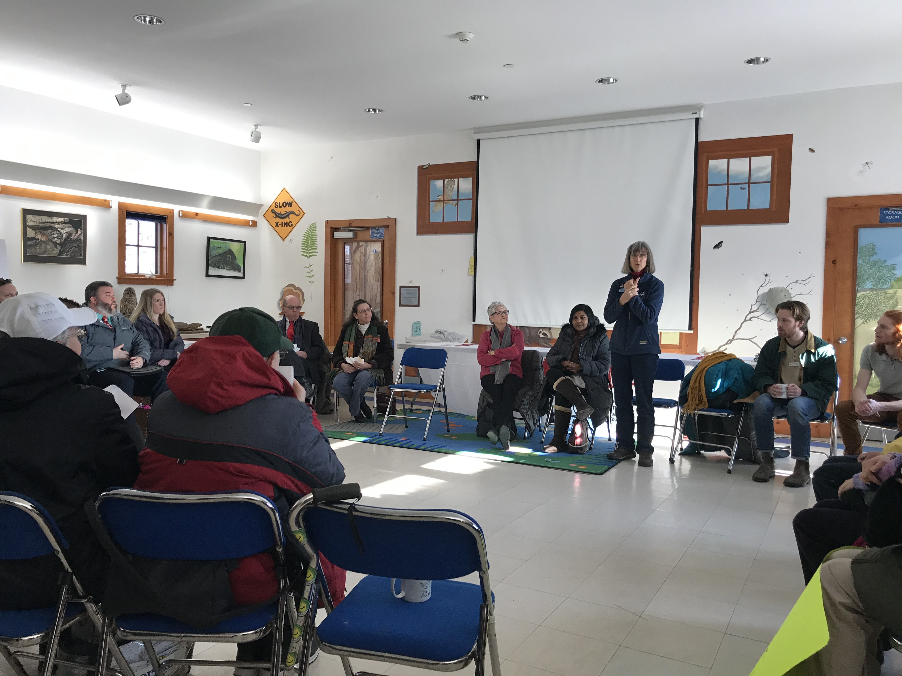
Consider a regional transportation group
Who:
Transportation officials & providers
Community organizations
Advocates
Others
Why:
Network
Share ideas & issues
Build partnerships
Expand transportation options
Human service agencies
Workforce development

Slide 35
Your Role With Transportation
How involved do you want to be? How involved do you need to be?
Commitment & Time | Level of Involvement
Limited Commitment & Time Large Commitment & Time | Find it: Find transportation for individual needs
 | Organize it: Identify available transportation options
 | Coordinate it: Make better use of existing options
 | Create and expand it: Create new options
Your level of involvement is going to depend on the existing transportation resources available

Slide 36
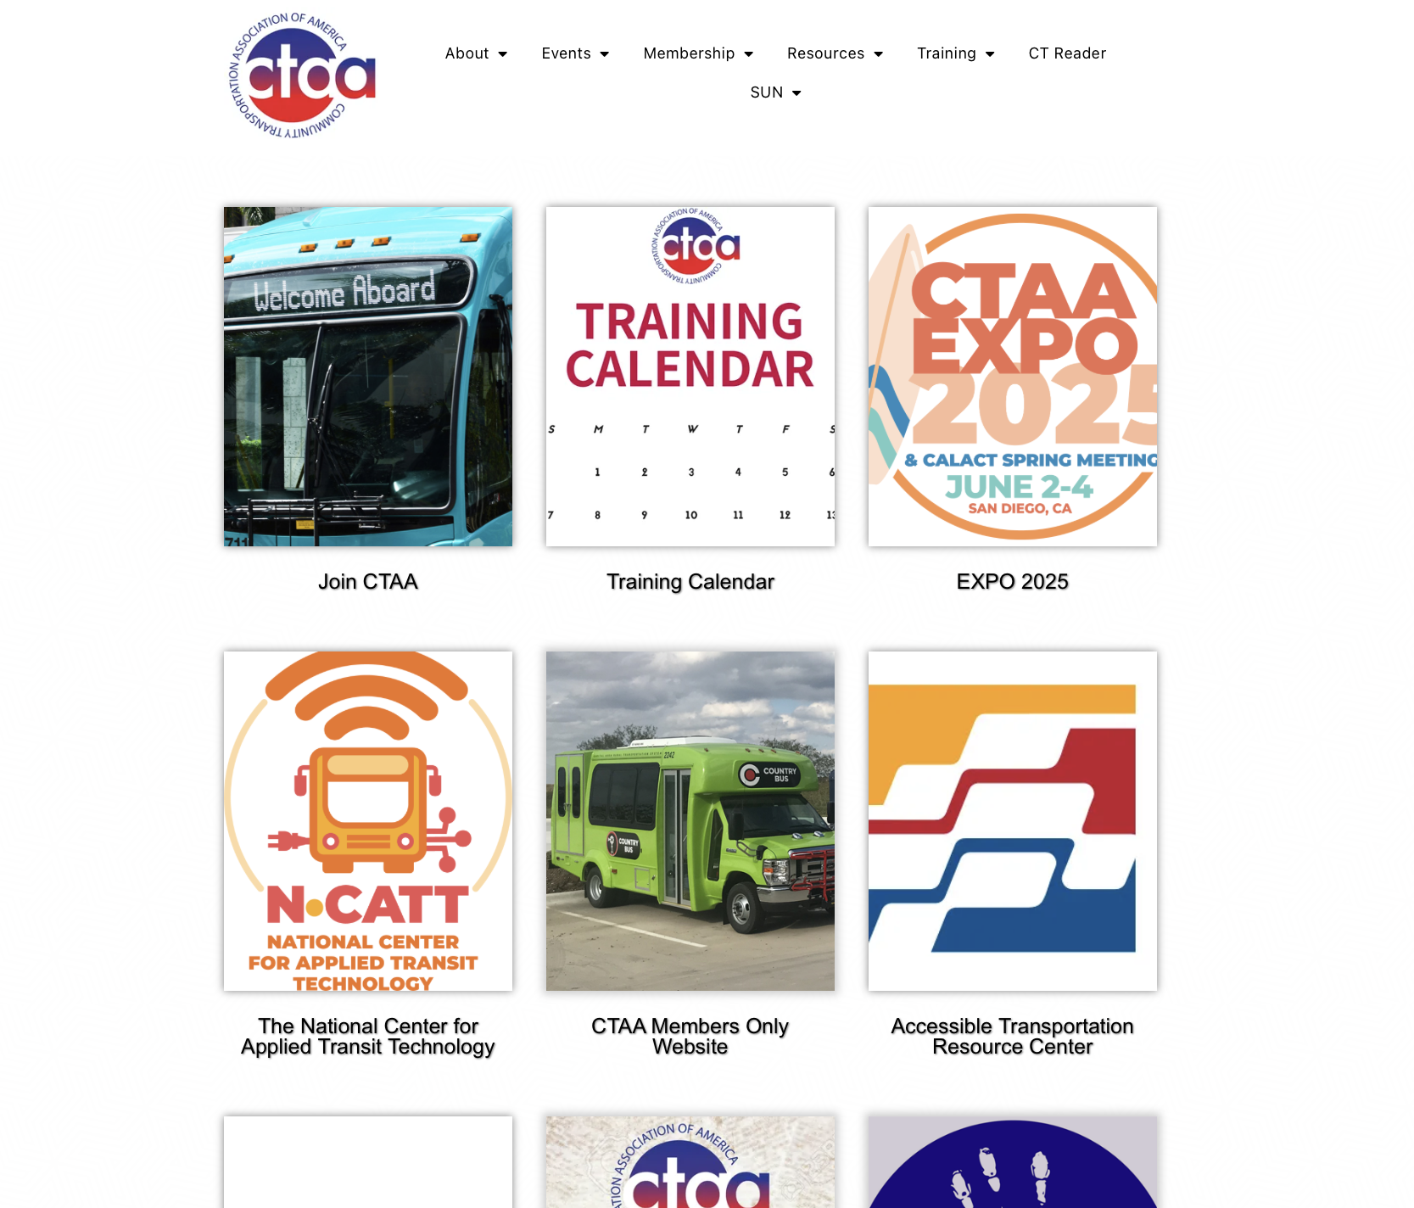
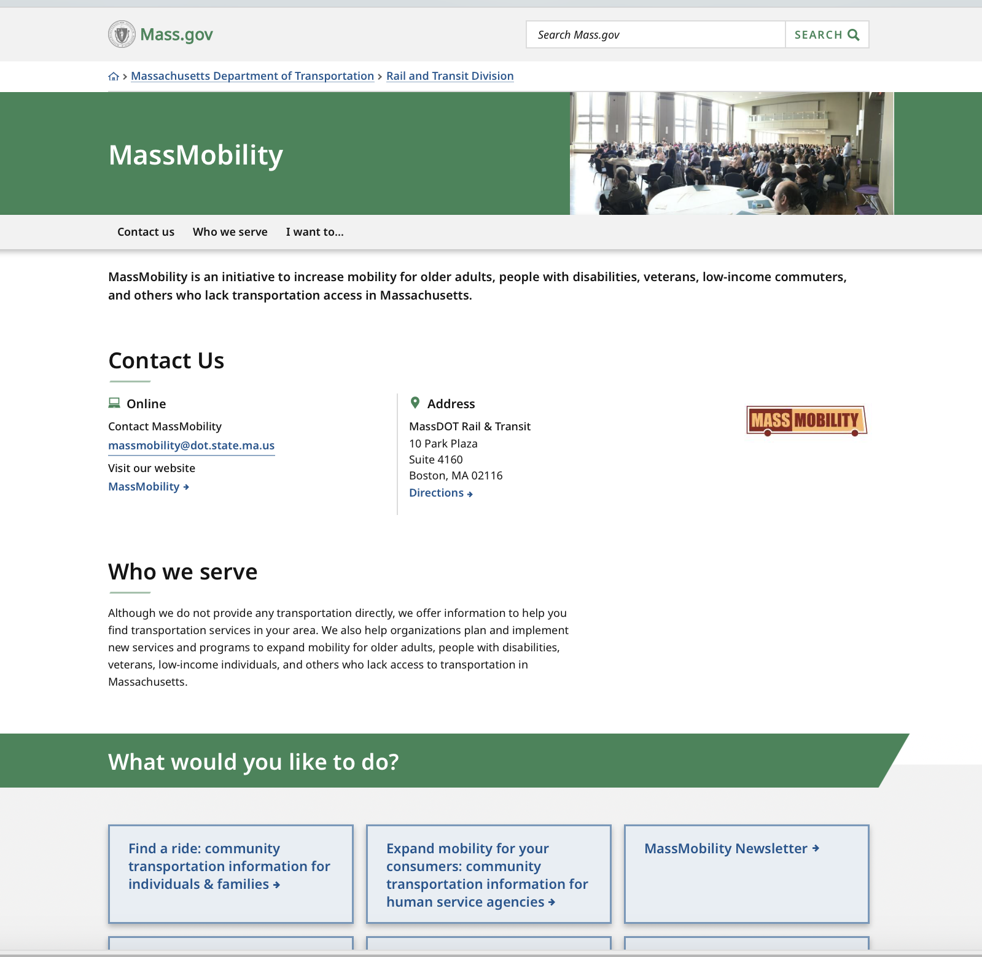
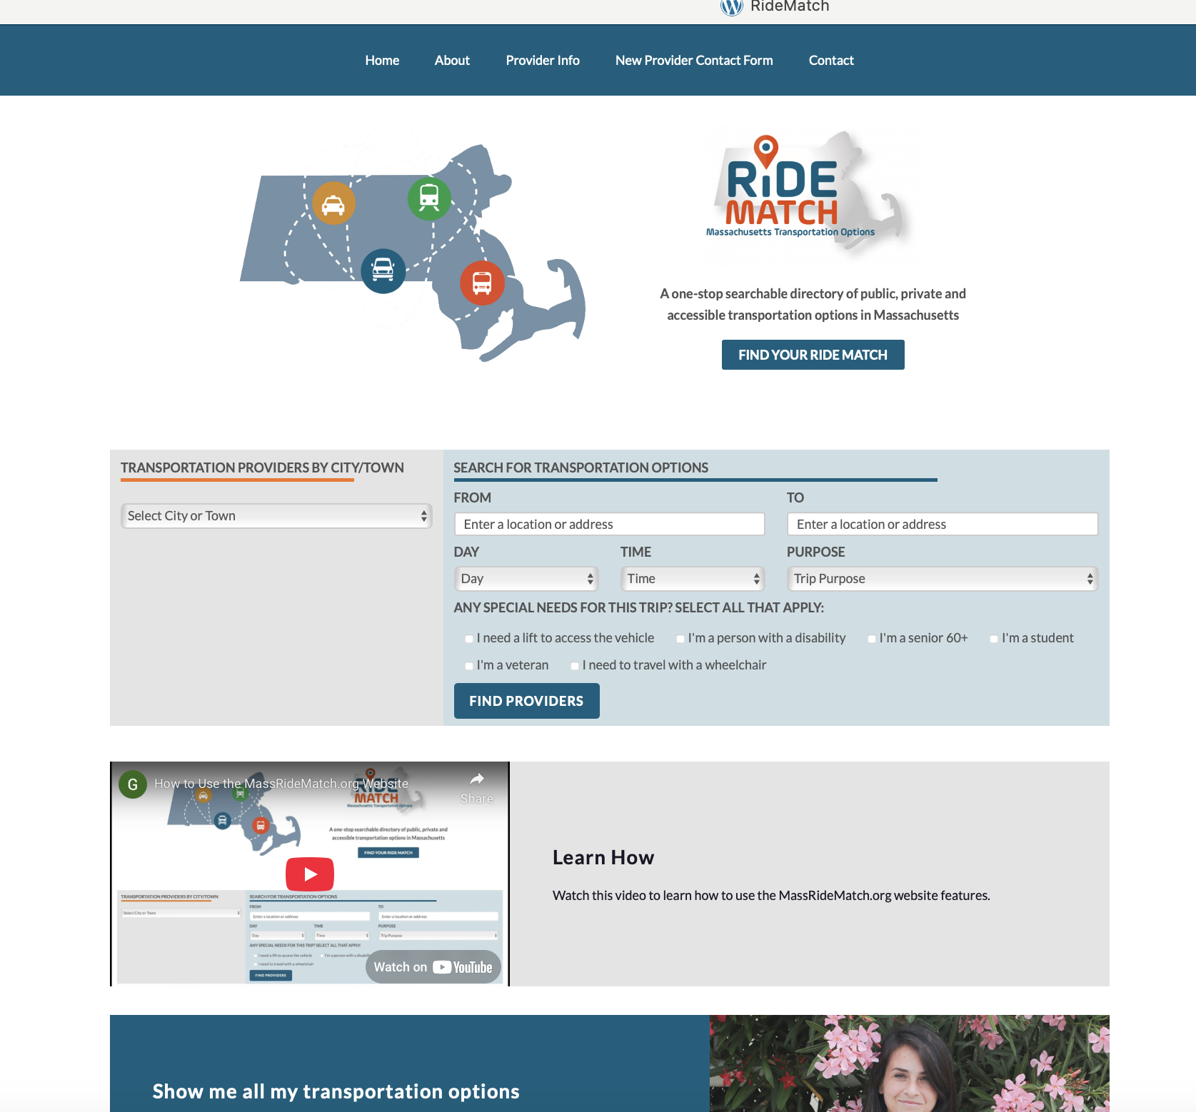
Exploring Resources

Slide 37
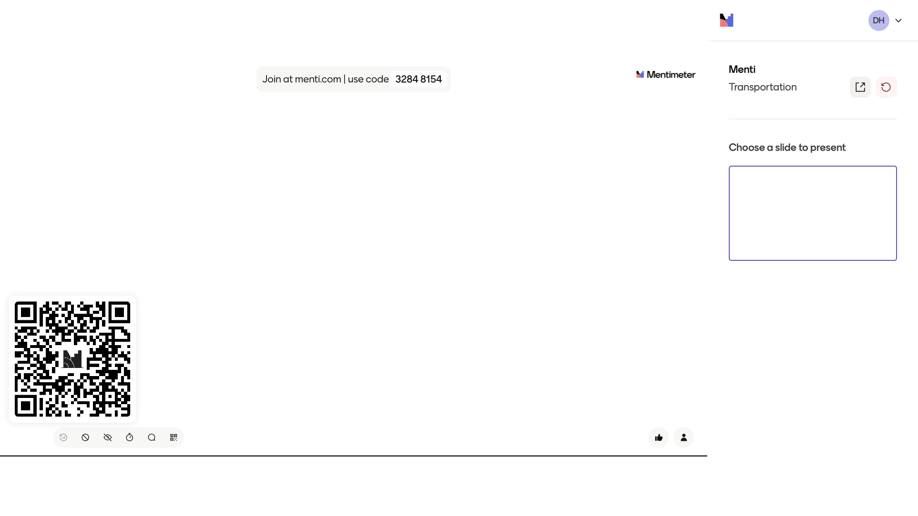
What steps or actions are you going to take as a result of this presentation?

Slide 38

The answer is out there, and it's looking for you, and it will find you if you want it to.

Slide 39
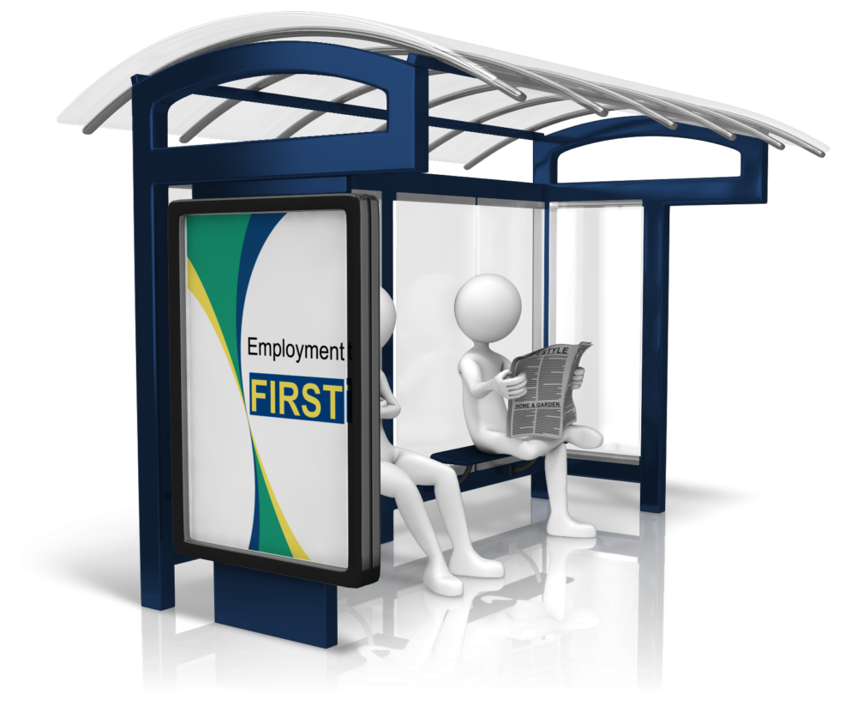


Questions, Comments, Discussion

